Slide 1
DeepDesign Midterm Presentation
Hedy Makris, Shreya Gurjar, Jeremy Randolph, Zachary Sisco

Slide 2
DeepDesign
“A branding project can help you figure out what and how to communicate your company’s story, but how much does it cost?”
---- techcrunch.com, 2019

Slide 3
PROBLEM
DeepDesign
Creating a logo and visual identity are integral to a company’s brand and connection to their customers and investors. However, creating a good logo can cost thousands of dollars which a lot of startups can’t afford.
Branding and marketing costs can reach into the tens of thousands, if not hundreds of thousands. These essentials have traditionally been reserved for exclusive design firms with expensive fees.

Slide 4
OUR SOLUTION: LoGAN
DeepDesign
DeepDesign utilizes state-of-the-art Artificial Intelligence to help startups build their visual identity and brand for a fraction of the cost of big firms.
Our generative algorithms paired with our design consultants can create superior visual content that is always unique.

Slide 5
DeepDesign
“Sites like Fiverr and 99designs offer cheap logos, but independent consultants like Pablo Defendini advise that if you can find a small budget, you’ll get far better results by hiring an experienced professional to create a more polished logo”
---- techcrunch.com, 2019

Slide 6
OUR BUSINESS MODEL
DeepDesign
B2C and B2B Capability
Startups, Established Companies, Independent Content Creators
Tiered Payment Plans
Individual logo purchases ($15), design consultations ($150/hr), premium services ($3.99/month or $6.99/month)
Additional Revenue Streams
Advertisements through social media and website channels
Continuous Growth
Referral program for customer growth
Notes:
**good slide to talk about what we are charging for the product**

Slide 7
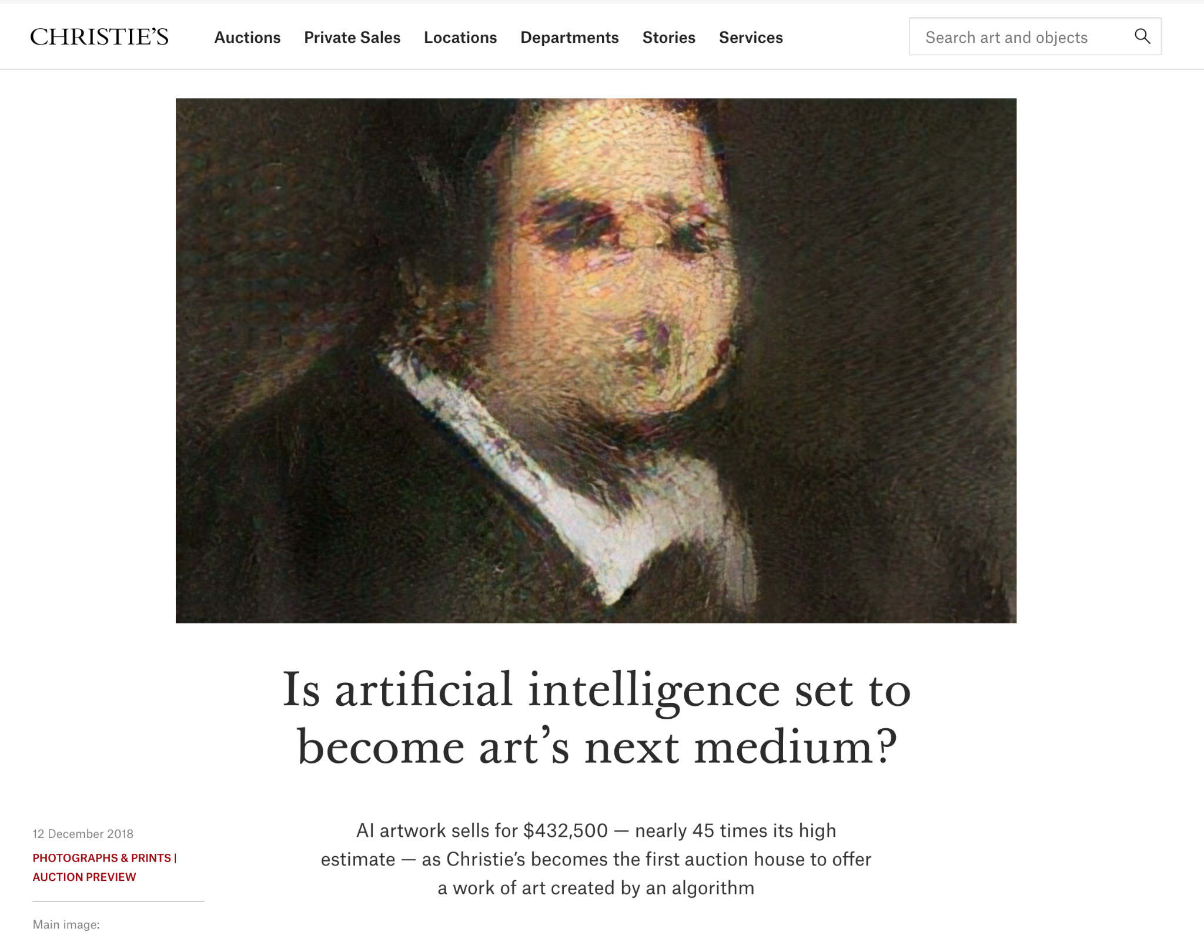
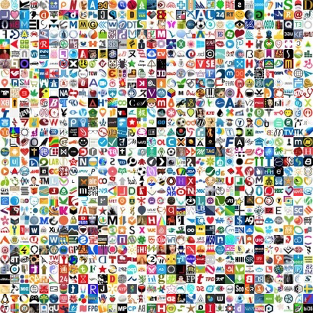
UNDERLYING MAGIC
DeepDesign
Notes:
Jeremy
-Talk about invention of gans
- Recent developments in GPU technology allowing increased performance
- Nvidia’s face generation stylegan has proven how gans can create near indistinguishable images
- With NFTs gans set to take over the art space
- AI is set to push the boundaries of graphic design

Slide 8
UNDERLYING MAGIC
DeepDesign
Uniqueness
Our A.I ensures that every logo generated is completely unique, just like our customers
Powerful Efficiency
Endless amount of possibilities that are cheap and easy to generate
Refinement
Our model will only get better with time, with complete customization on the horizon
Notes:
**good slide to talk about what we are charging for the product**
Jeremy

Slide 9
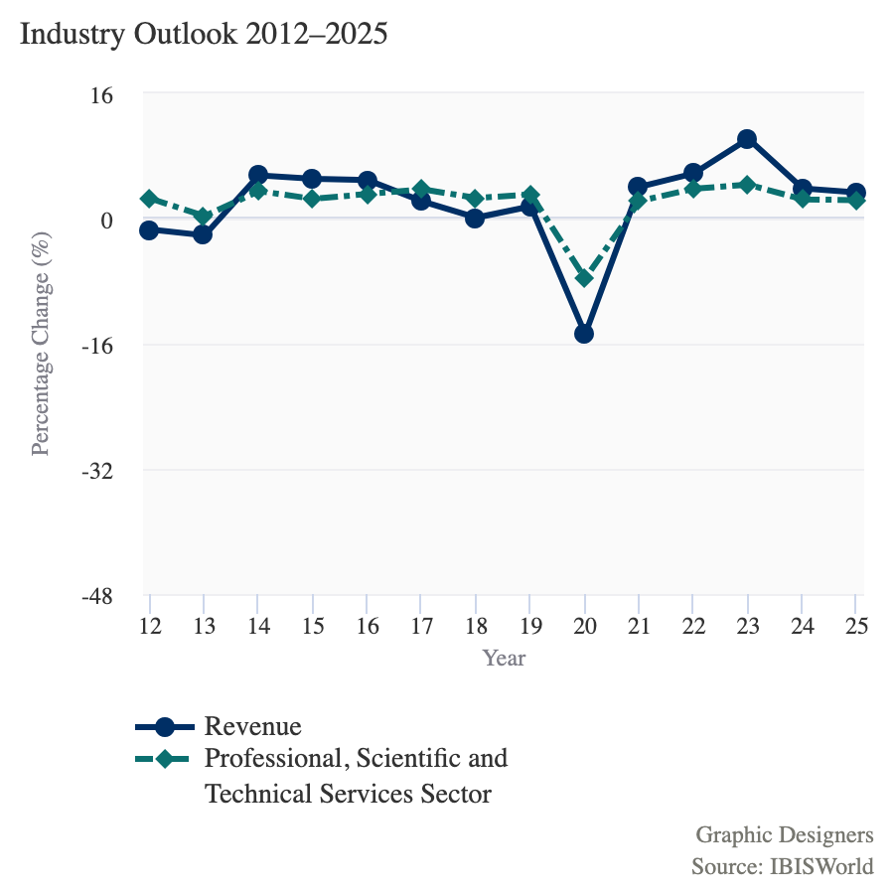
MARKET POTENTIAL
DeepDesign
Graphic Design Industry, USA
2012-2025
Over the five years to 2025, industry revenue is projected to grow at an annualized rate of 5.4% to $15.9 billion.
Graphic Designers
Source: IBISWorld
Notes:
The graphic design industry is projecting annualized growth rate by 5.4%, resulting in a revenue of $15.9 billion dollars over the next five years. Due to COVID-19 there, there was a dip in need for graphic designer, however there is a upward trend in this industry as the lockdowns ease. With the increase of self branding from content creators and influencers in social media, the demand for logo and brand design has a positive outlook.

Slide 10
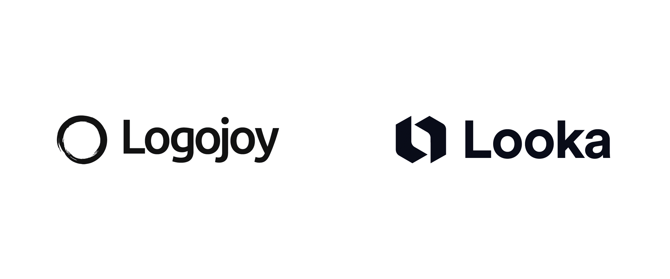
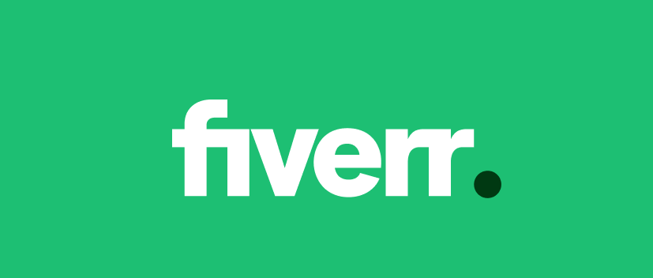
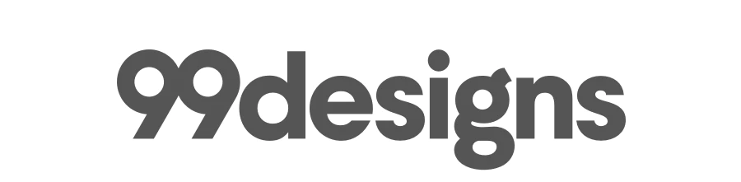
COMPETITION
DeepDesign
DeepDesign
AI Logo Generation
Custom Marketing Assets
Consultant Designers | (optional)
Price (Logo) | $15 | $20-80 | Varied | $299-$1299
Notes:
-99designs: Connects designers with clients for logo creating, web design and various other graphics related services
-fiverr: Online marketplace for freelance services / Choose from various designers offering their services
-Looka: Combines design preferences with A.I to generate logos/ Create custom marketing assets

Slide 11
PROJECTIONS & MILESTONES
Year 1
Year 3
Year 5
Minimum Viable Product
20% Growth, Looka Acquisition
Year 2
Year 4
DeepDesign
9% Growth, Loss
14% Growth
Breakeven, 12% Growth, Profitable
16% Growth, Makeable Acquisition
Notes:
Our timeline is moreso focused on our technical development. We are right at the end of stage one and beginning of stage two. We have finalized our concept and we have some great datasets that Jeremy talked about and we have sourced coding frameworks that will be needed to complete the project in the limited time. We anticipate Gan development will take 1-1.5 months and training the model would take somewhere between 1-2 weeks for us to be able to demonstrate proof of concept. Final two weeks will be reserved for evaluation of the model before going to market.

Slide 12

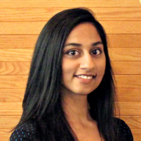


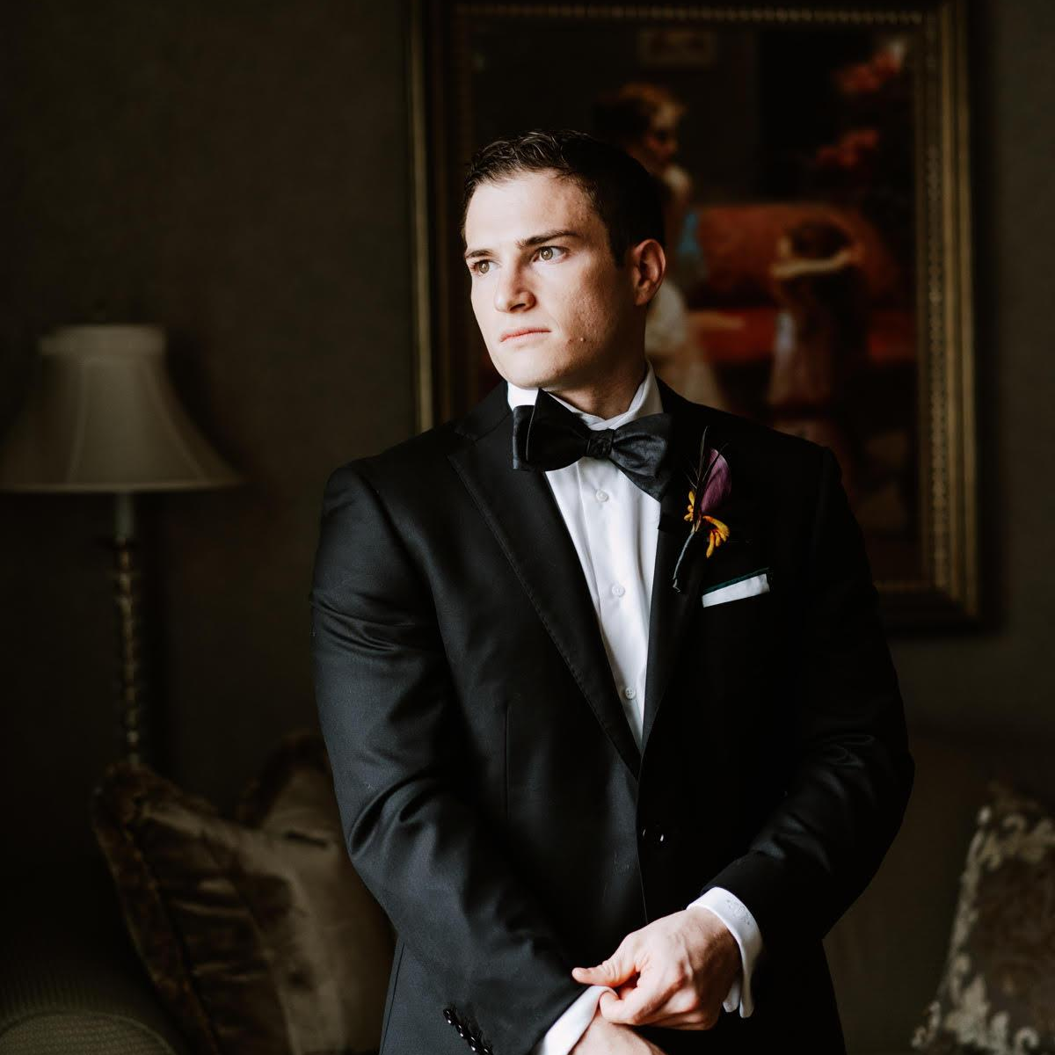
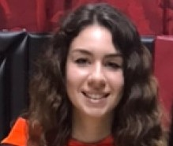
THE TEAM
Zach Sisco
CEO
Shreya Gurjar
CMO
CTO
Jeremy Randolph
CFO
Hedy Makris
Financial Risk Analyst, Business Consultant
DeepDesign
Tech Consultant, 3 years of Project Management
Market Research &
Data Analyst
2 years of tech development, ETL developer
Notes:
Our team is comprised of Zach our Chief Executive Officer, Shreya our Chief marketing officer, Jeremy our chief technology officer and myself the chief financial officer.

Slide 13
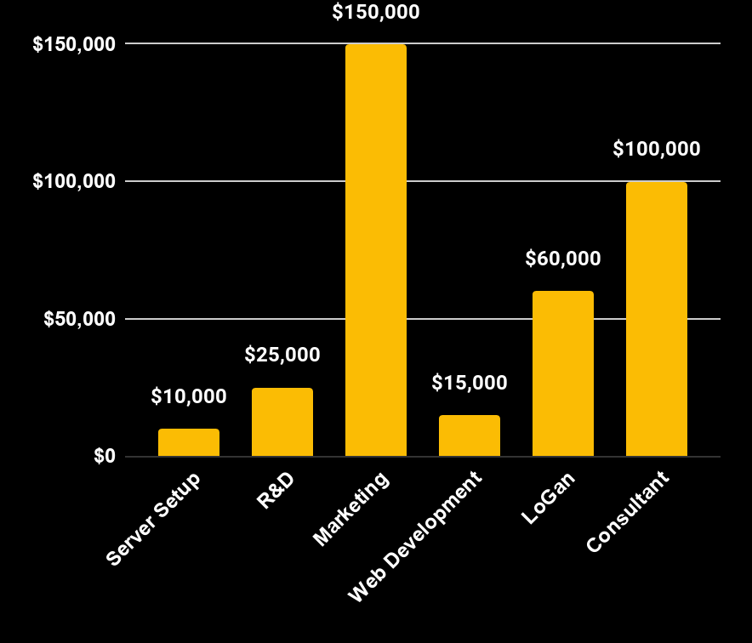
DeepDesign VALUATION
Initial Investment
$360K
Investor’s Shares
16%
5Y Return
ROI: 6.40x
$8.8M Revenue
$2.9M Profit
DeepDesign Worth at Year 5: $14.5M
DeepDesign
Initial Investment $230,000
Company’s worth $6.9M (after 5 yrs)
Investor’s share 20%
Investor will receive $1.4M (after 5 yrs)
ROI 6.08x

Slide 14
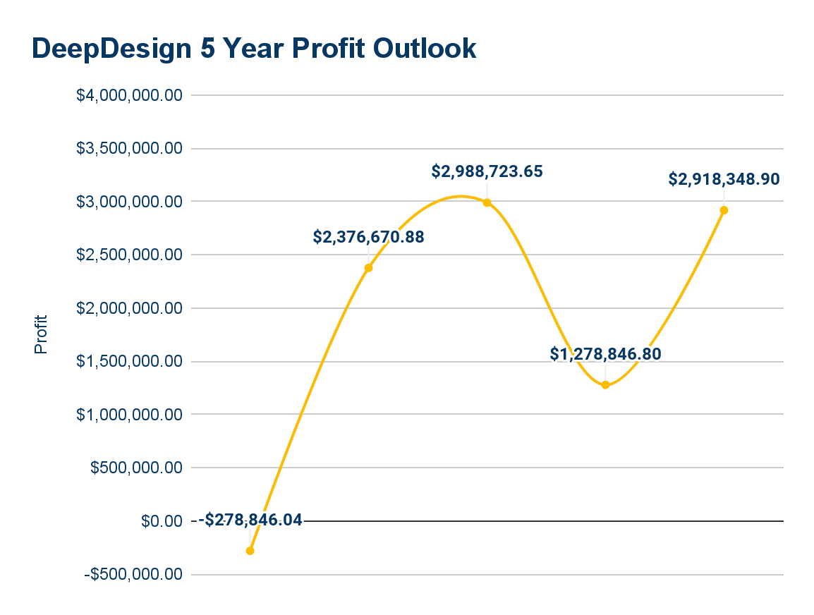
BECOME A PARTNER
$360,000 for 16%
ROI: 6.40x
DeepDesign

Slide 15
THANKS!
Does anyone have any questions?
Notes:
Thank you so much for listening to our presentation and if you have any questions please feel free to ask.

Slide 16
DeepDesign
DEMO

Slide 17
Appendix

Slide 18
SWOT ANALYSIS
Strengths Guaranteed unique designs for cheap, skilled design consultants | Weaknesses Freelance designers can be cheaper
Opportunities Ever-expanding startup ecosystem, few competitors using our tech | Threats Sites like fiverr, 99designs, and Looka

Slide 19
PORTER’S FIVE FORCES
Competitive Rivalry
Moderate. Freelance sites are numerous, but they don’t offer consulting and extended branding work
Supplier Power
Low. We are the supplier, and designers are numerous.
Buyer Power
Moderate. Freelance sites offer cheaper options.
Threats of Substitution
Moderate. People can design their own logos, but few can execute branding.
Threat of New Entry
Moderate. Many people can create a similar algorithm.

Slide 20
Intellectual Property
US20190156537A1 - Method for digital design generation utilizing variation based design to preserve dominant qualities and characteristics of a base design
US20100100840A1 - Method for interactively designing a logo - GUI allows the user to select from set of presented characteristics (image and/or type of industry) to generate logo
Notes:
Through our intellectual property search we were able to identify two patents that were related to our project. First is a method for automated design generation with the ability to preserve desired user input parameters while also introducing variation to create several possible options based off a base design. This patent is actually from LOGOJOY who now became LOOKA and is one of our competitors. The second patent is for a GUI which allows users to input desired characteristics and design a logo that incorporates those selected features.

Slide 21
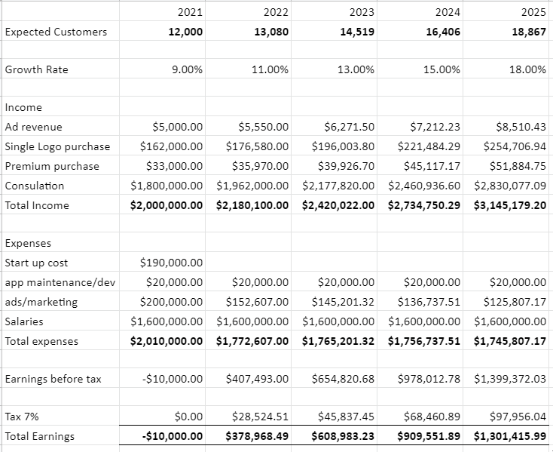
ProForma
 | 2021 | 2022 | 2023 | 2024 | 2025
Expected Customers | 12,000 | 13,440 | 15,322 | 17,773 | 21,328
Growth Rate | 9.00% | 12.00% | 14.00% | 16.00% | 20.00%
Income
Ad revenue | $5,000.00 | $5,600.00 | $6,384.00 | $7,405.44 | $8,886.53
Single Logo purchase | $162,000.00 | $181,440.00 | $206,841.60 | $239,936.26 | $287,923.51
Premium purchase | $79,056.00 | $88,542.72 | $100,938.70 | $117,088.89 | $140,506.67
Consultation | $1,800,000.00 | $4,032,000.00 | $4,596,480.00 | $5,331,916.80 | $6,398,300.16
Acquisition Revenue | $0.00 | $0.00 | $0.00 | $2,500,000.00 | $2,000,000.00
Total Income | $2,046,056.00 | $4,307,582.72 | $4,910,644.30 | $8,196,347.39 | $8,835,616.87
Expenses
Start up cost | $380,000.00
App maintenance/dev | $5,000.00 | $5,000.00 | $5,000.00 | $5,000.00 | $5,000.00
ads/marketing | $439,902.04 | $395,911.84 | $356,320.65 | $320,688.59 | $288,619.73
Salaries | $1,500,000.00 | $1,530,000.00 | $1,560,600.00 | $1,591,812.00 | $1,623,648.24
Acquisitions | $0.00 | $0.00 | $0.00 | $5,000,000.00 | $4,000,000.00
Total expenses | $2,324,902.04 | $1,930,911.84 | $1,921,920.65 | $6,917,500.59 | $5,917,267.97
Earnings before tax | -$278,846.04 | $2,376,670.88 | $2,988,723.65 | $1,278,846.80 | $2,918,348.90

Slide 22
OUR BUSINESS MODEL CANVAS
Key Partners
Startups
Established Companies
Designers
Web services
Key Activities
Consulting
Designing
Platform Maintenance
Value Proposition
A quick and cost-effective way to create your
company’s visual
identity and
establish your brand
Customer Relationships
Customer service
Referral program
Customer Segments
Start-ups
Freelancers
Individuals
Influencers
Content creators
Key Resources
Servers
Design consultants
Channels
Website
Social Media
Cost Structure
Revenue Streams
Server space, designers, consultants, domain fees, admin, marketing
Services revenues, premium purchases, advertising

Slide 23
Google Adword Campaign
“Brand”
“Logo”
“Graphic designer”
CPC: $1.88 Avg
CAC: $1.88 * 50 clicks= $94
CPC: $1.45
Volume: 110K
CPC: $1.75
Volume: 368K
CPC: $2.45
Volume: 165K
Notes:
We identified three keywords related to our company and those words are brand, logo and graphic designer. We took the average cost per click of those three keywords and got $1.88. We estimated having approximately 50 clicks we would have a customer acquisition cost of about $100.

Slide 24
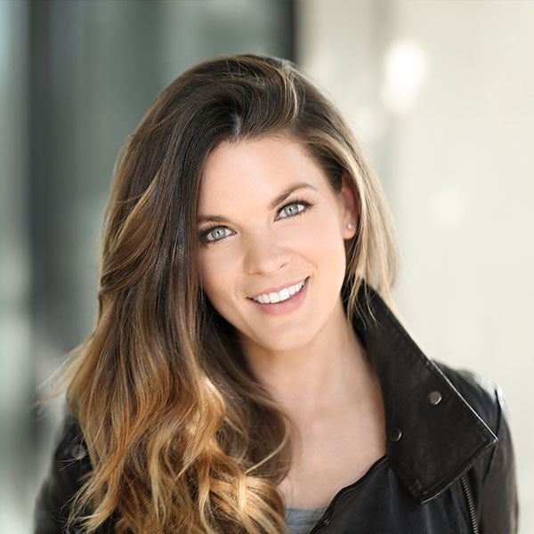
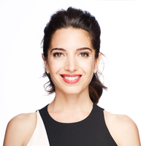
Influencers
Sunny Lenarduzzi
Marie Foreleo
Various Self Branding Content Creators
Youtubers
Instagram Influencers
Twitch Streamers
Sunny Lenarduzzi
Marie Foreleo
Notes:
Sunny Lenarduzzi is a online content creator focused around entrepreneurship, we can have a sponsored video dedicated to her creating a logo and other marketing assets as a video to help reach a larger audience
Marie Forelo is an author and entrepreneur who has worked with celebrities like Oprah to share her knowledge through free content and online programs
Partner with other large content creators who are looking to build their own brand (beauty / makeup creators, fitness creators, etc)

Slide 25
Marketing Segmentation
Firmographic
Behavioral
Psychographic
Geographic
First time Entrepreneurs
Content Creators/ Influencers
Freelance Graphic Designers
High Social media usage
Usage of website design applications
Graphic design platform users (ie. Canva)
Self branding
Good Saver
Well connected
Artistic
NY Metropolitan Area
Expand throughout North America

Slide 26
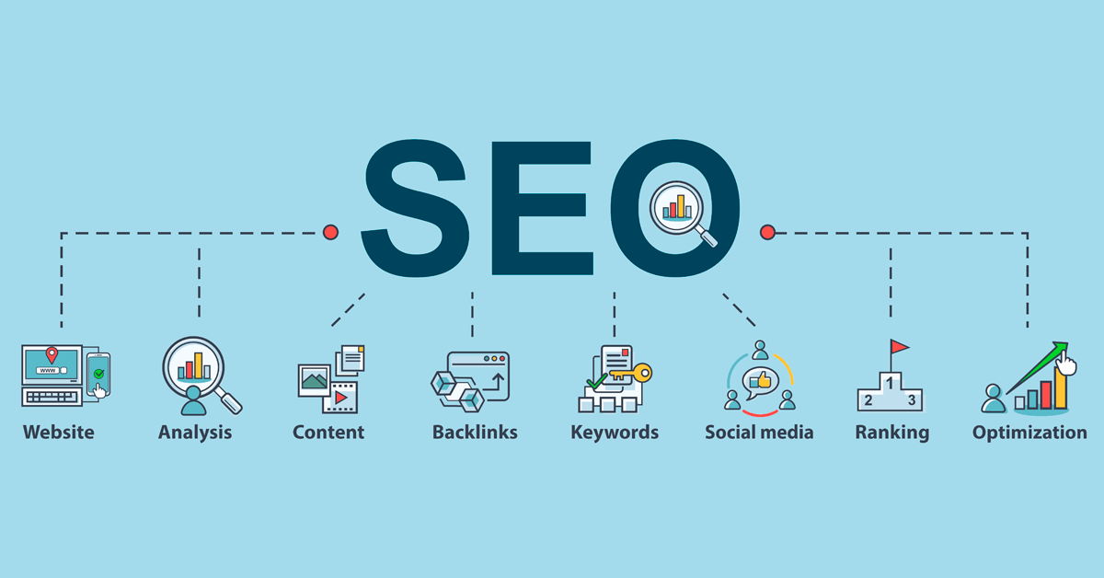
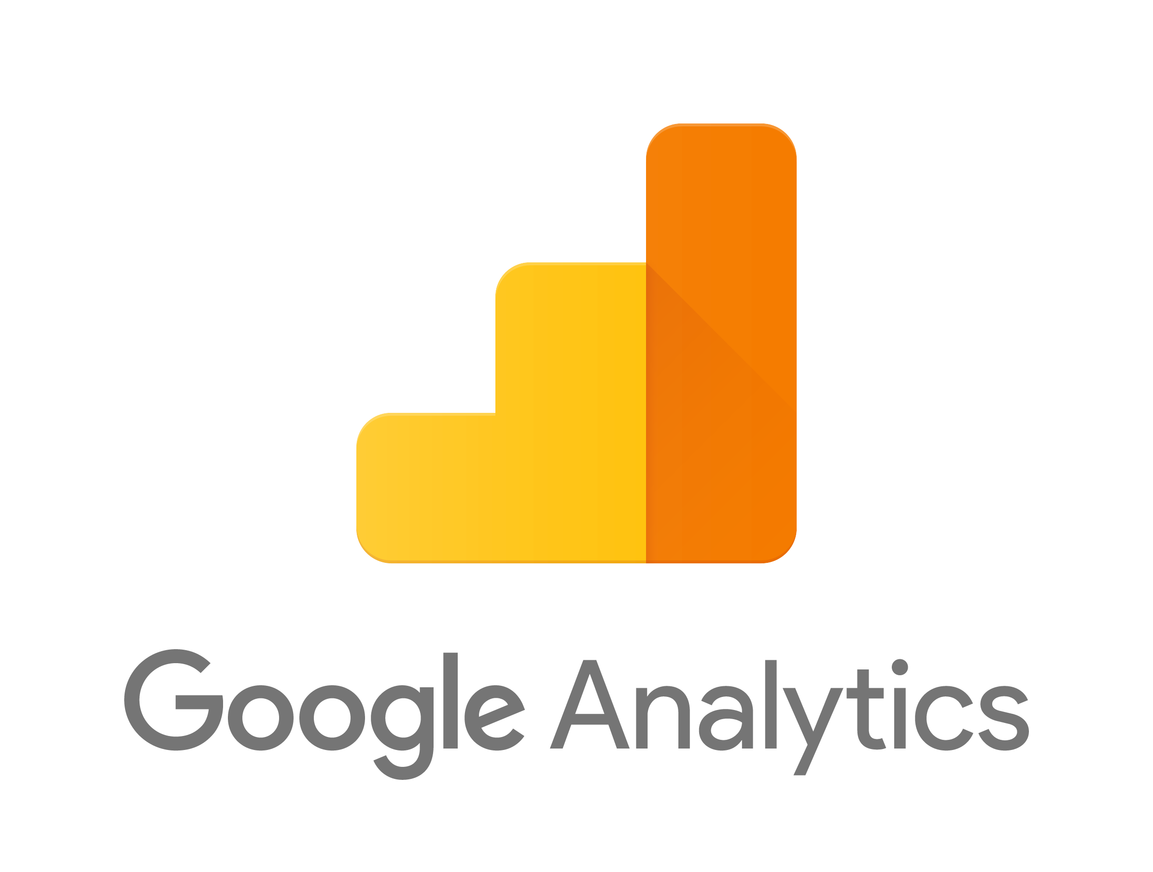
Search Engine Optimization
Have optimal UXD for the website
interactive
colorful
easy to navigate
Assure website safety and accessibility
HTTPS
mobile friendly
Use Google Analytics to analyze landing pages
analyze keyword searches

Slide 27
HORIZONTAL/VERTICAL ACQUISITIONS
Horizontal Acquisition Opportunity
Looka, an AI-driven design agency and one of our competitors, will add revenue of $2M
Vertical Acquisition Opportunity
Makeable, a boutique design agency and consulting firm, will add revenue of $2.5M
DeepDesign

Slide 28
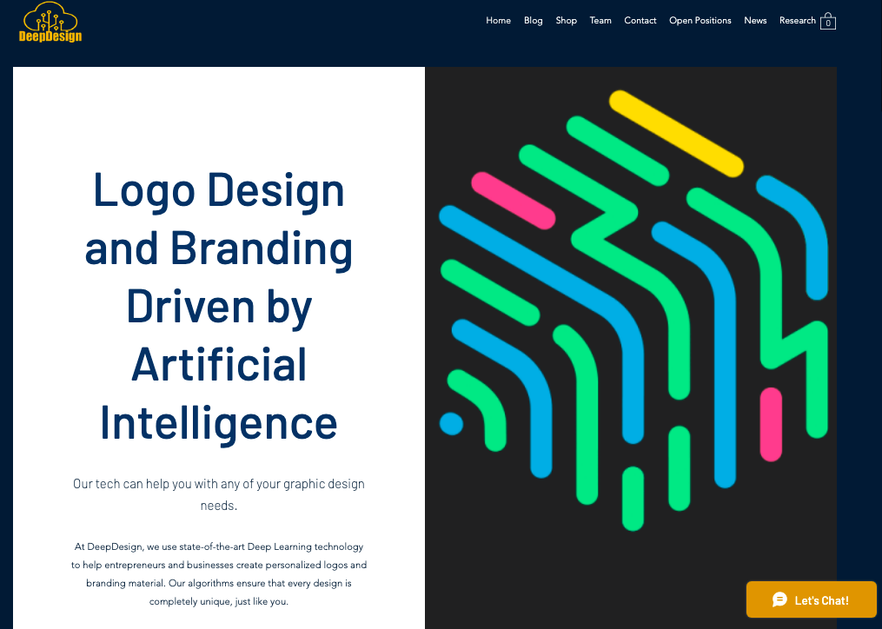
WEBSITE
Click Here
https://deepdesigninfo21.wixsite.com/deepdesign
DeepDesign

Slide 29
BIZ-BUY-SELL
DeepDesign - based in the NYC metro area
5+ years of experience utilizing Artificial Intelligence to help startups build their visual identity and brand for a fraction of the cost of big firms.
Patent Pending Technology
20K+ loyal customers
3M+ revenue in 2025
Diverse management with backgrounds in Analytics, Marketing and Design
Asking: $17,000,000
Competition: No other company uses our patent pending technology to create new never-before-seen logos with StyleGAN
Employees: 4 senior level associates, 5 consultant/managers
DeepDesign

Slide 30
VALUATION
$360,000 for 16%
ROI: 6.40x
DeepDesign

Slide 31
ASK CALCULATIONS
DeepDesign
The Investment
Initial Investment= $360,000
Company’s valuation = 5 x $2,918,348.90 = $14,591,744.49
Pre-money value = $14,591,744.49 / (1.5)^5 = $1,921,546.60
Post-money value = $1,921,546.60 + $360,000 = $2,281,546.60
The Ask
Equity = $2,281,546.60 / $360,000 = 15.78%
The Ask= $360,000 for 15.78% share in our company
The Return
Investor will receive = 15.78% of $14,591,744.49 = $2,302,397.86
ROI= $2,302,397.86 / $360,000 = 6.40x
Initial Investment $230,000
Company’s worth $6.9M (after 5 yrs)
Investor’s share 20%
Investor will receive $1.4M (after 5 yrs)
ROI 6.08x

Slide 32

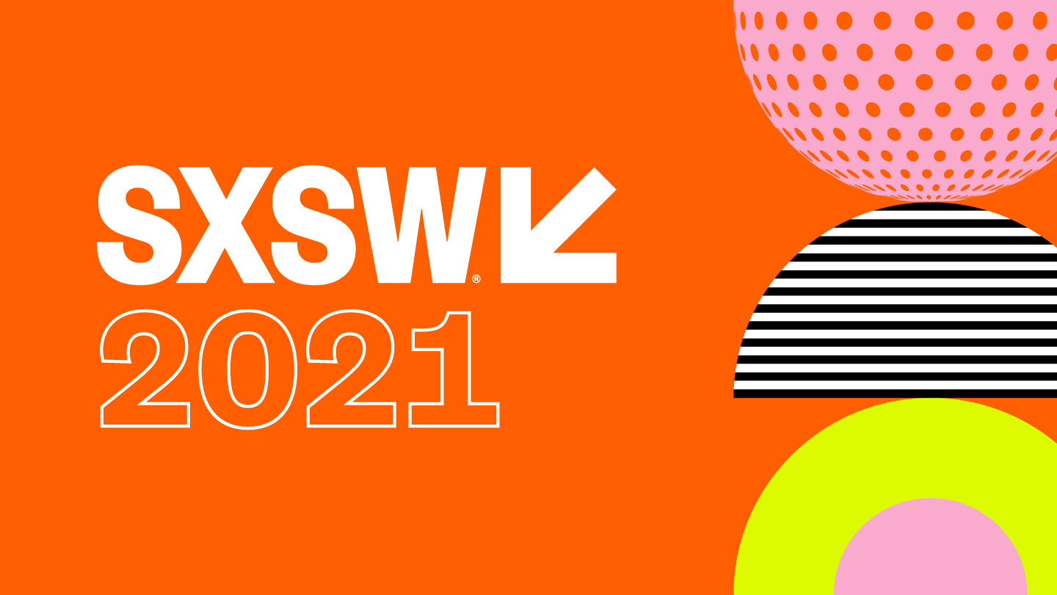
POP-UP VENUE
Set up kiosks to demo the application and raffle off a free usage for one small business
Small Business Expo
Locations: Philadelphia, New York City, San Francisco
SXSW
Location: Austin, TX
DeepDesign

Slide 33

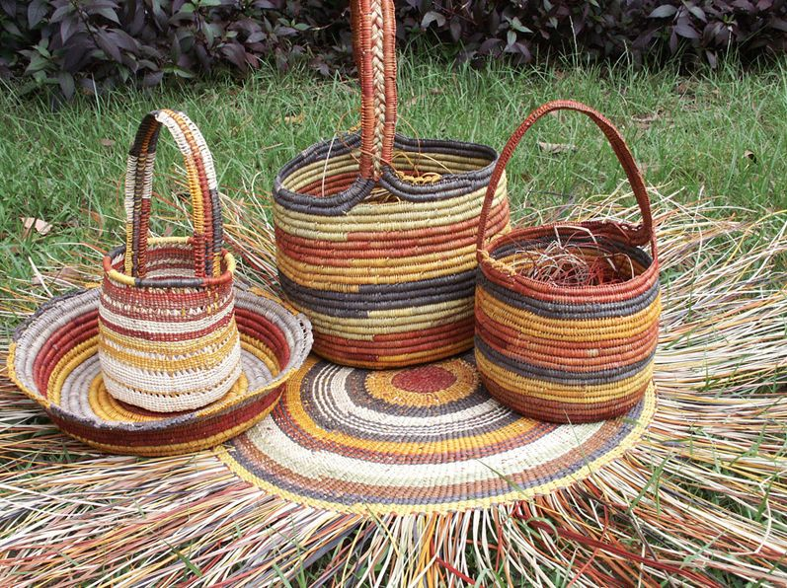

SOCIAL RESPONSIBILITY
Every year DeepDesign offers 1,000 Kiva entrepreneurs from the Arts and Mission Driven sectors a free logo with our company
DeepDesign
since 2005
1.6 million loans
totalling over $1.33 billion
96.2% repayment rate
Arts
Mission Driven
Notes:
Focus on Arts and Mission Driven Loans Given through Kiva
End of the year: offer one Kiva startup a free logo with our company
https://www.kiva.org/
unlike regular charity donations, KIVA provides LOANS to those who may need it and have see
We do this by crowdfunding loans and unlocking capital for the underserved, improving the quality and cost of financial services, and addressing the underlying barriers to financial access around the world. Through Kiva's work, students can pay for tuition, women can start businesses, farmers are able to invest in equipment and families can afford needed emergency care.
Whether it’s reinventing microfinance with more flexible terms, supporting community-wide projects or lowering costs to borrowers, we are always testing and learning.

Slide 34
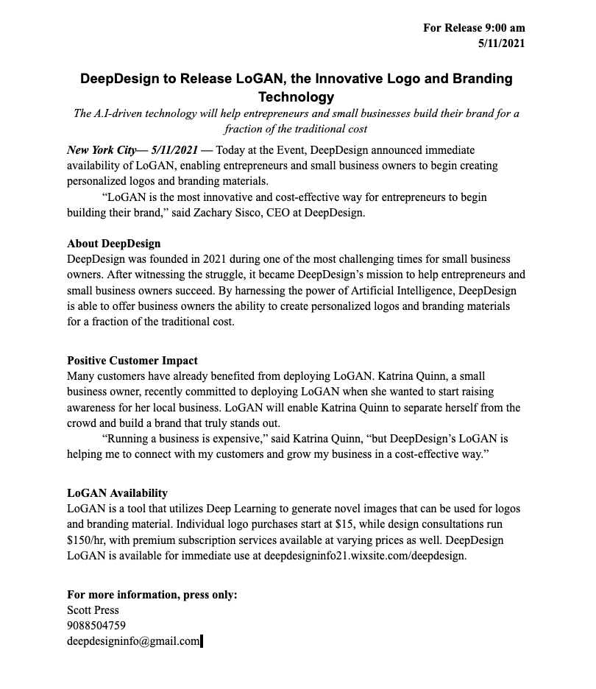
PRESS RELEASE
DeepDesign

Slide 35
FLAT ORGANIZATIONAL STRUCTURE
DeepDesign
Zach Sisco, CEO
Tech Consultant, 3 years of Project Management
Hedy Makris, CTO
Financial Risk Analyst, Business Consultant
Jeremy Randolph, CTO
ETL Developer
Shreya Gurjar, CMO
Market Research &
Data Analyst
Employees

